Slide 1
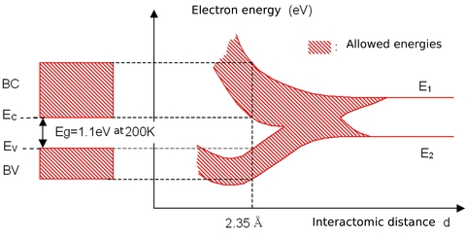
Formation of energy bands
A solid contains large number of atoms packed together. A single isolated atom has discrete energy levels. As N number of atoms comes together to form a solid, a continuously increasing interaction occurs between them. The interatomic distance specifies the amount of overlap that causes splitting.

Slide 2
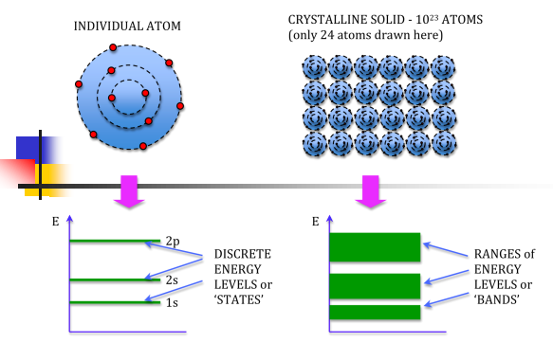

Slide 3
When two identical atoms are brought closer together, the quantized energy levels hybridize and split into two different levels because of the mutual interaction of the two atoms.
More generally, when N atoms are moved closer, until they reach the equilibrium inter-atomic distance d, the energy levels split into N levels. These N levels are very close to each other if N is large (which is the case in a crystal) so that they eventually form a continuous energy band.
The band formed by series of energy levels containing the valance electrons is called the valance band. It is the highest occupied allowed energy band. It may be completely filled or partially filled with electrons.
The next higher permitted energy band is called the conduction band. It is the lowest unfilled permitted energy band. It may be empty or partially filled with electrons. The electrons can move freely in the conduction band, hence the electrons in the conduction band are called as conduction electrons.
The energy band between the valance band and the conduction band is called the forbidden energy gap or the forbidden band. This energy gap is denoted by Eg and is the amount of energy to be supplied to the electrons in the valance band to get excited to the conduction band.

Slide 4
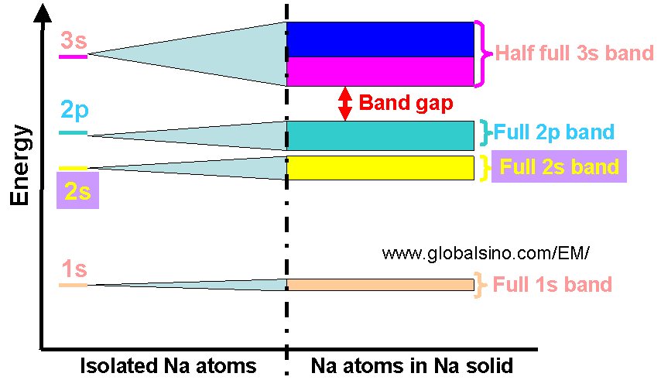

Slide 5
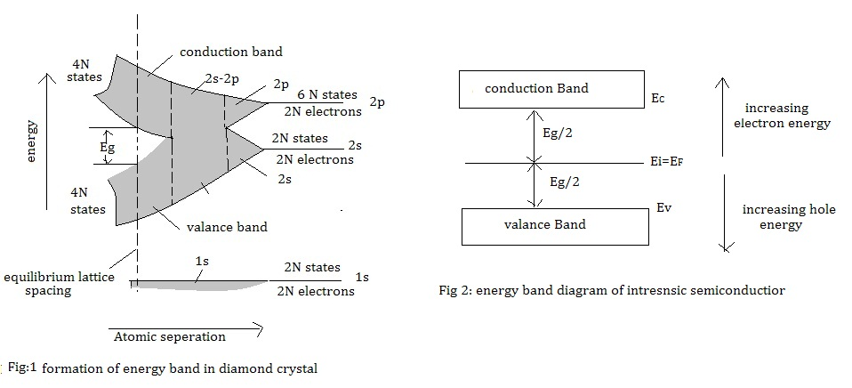

Slide 6
Classification of Solids on the basis of band theory
The electrons in the innermost filled shells do not take part in conduction process.
Electrons in the conduction band are free and move easily under the application of electric field.
The electrons in the valance band are attached to the lattice.
If they acquire sufficient energy to cross the forbidden gap, they can occupy the conduction band states and available for conduction.
Hence Eg is the parameter which decides whether the material acts as a conductor, insulator or semiconductor.
On the basis of the band theory, solids are classified into :
Insulators,
Conductor and
Semiconductors.

Slide 7
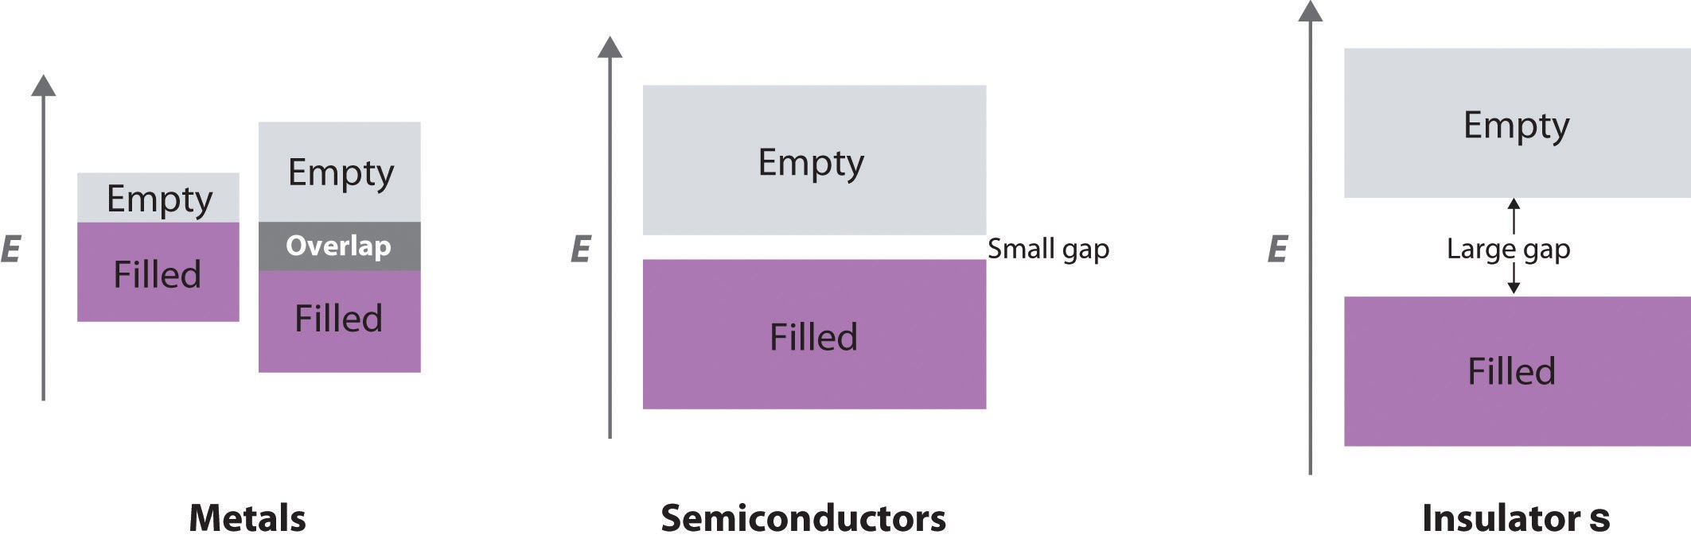

Slide 8
Insulators
In insulators valance electrons are bound very tightly to their parent atoms. Hence very large electric field is required to remove them from attraction of nuclei. Features of Insulators are:
A full valance band
An empty conduction band
A large energy gap (≈ 5 to 10 eV)
Very high resistivity ( of the order of 10⁹ Ω cm)
For some materials at high temperature and under sufficient electric field, some electrons may move to the conduction band showing little conductivity at higher temperatures.

Slide 9
Semiconductors
A semiconducting material has electrical properties between those of insulators and good conductors.
Features of semiconductors are:
Almost empty conduction band and a filled valance band with narrow energy gap (≈1 eV)
At 0 K, the valance band is completely filled and conduction band is empty. At room temperature some of te valance electrons gains enough energy to cross the small energy gap and move to the conduction band. The electron moving to the conduction band leave behind a vacancy called as hole which has a tendency to accept the electron like positive charge. When the hole is captured by another valance electron it creates vacancy behind completing the covalent bond. Hence semiconductor current is the sum of electron and hole current flowing in opposite directions.
Resistivity varies from 10⁻¹² to 10⁹ Ω cm)
Example: Ge, Si etc

Slide 10
Conductors
The conductors have large number of free electrons available for electrical conduction. In conductors conduction band and valance band is overlapped, which is partially filled at any temperature. As there is no forbidden gap, there is no structure to establish holes. The total current is due to the flow of electrons. Features of conductors are:
Low resistivity (≈10-6 Ω.cm)
Example: copper, silver, gold

Slide 11
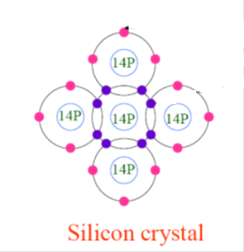
Intrinsic Semiconductors
Pure semiconductors are called intrinsic semiconductors. At 0 K all the valance electrons are paired in the covalent bonds. Since no electrons are there in the conduction band, it behaves as insulator at 0 K. E_{g} is 1.1 eV for Si. At room temperature some of the valance electrons acquire thermal energy greater than E_{g} and hence they jump to the higher energy band called conduction band leaving behind a vacancy called hole. They now act as free electrons and can move under the influence of small electric field. Holes created in the valance band have a tendency to accept the electron. If any valance electron jumps to the vacant state then it creates another vacancy behind. Hence the direction of holes is opposite to that of electrons

Slide 12
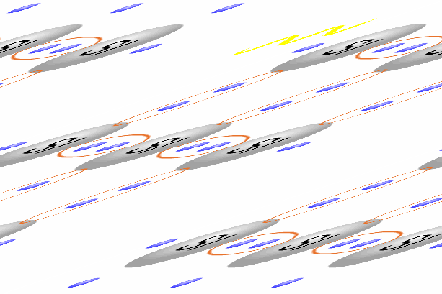

Slide 13
The total current is the sum of electron current and hole current. At any given temperature concentration of electrons in conduction band is same as the concentration of holes in the valance band.
Hence in intrinsic semiconductors n_{e} = n_{h} = n_{i},
n_{e} = Number of electrons per unit volume or electron density
n_{h} = Hole density
n_{i} = Intrinsic carrier concentration
Here, n_{e} = N exp (-E_{g} / 2KT)
Where N = possible states per unit volume
E_{g} = Forbidden energy gap
K = Boltzmann constant
The concentration of conduction electrons in intrinsic silicon, n_{i}, depends exponentially on E_{g} and the absolute temperature (T)
The conductivity in intrinsic semiconductor is given by,
σ_{in} = n_{e}. e. μ_{e} + n_{h}. e. μ_{h}
where n_{e} and n_{h} are number of electrons and holes respectively
e is the charge of electron
μ_{e} and μ_{h} is the mobility of electrons and holes respectively.

Slide 14
Extrinsic Semiconductors
Addition of controlled quantity of impurity to an intrinsic semiconductor to increase the conductivity is called as extrinsic semiconductor. The impurity atoms occupy lattice positions. Two types of extrinsic semiconductors are produced depending upon the group of impurity atom.
n-type semiconductor:
If a pentavalent impurity (donor impurity) is added to pure semiconductor, n type semiconductor is formed.
Consider Phosphorous (P) atom (pentavalent) is doped in Si crystal. Each P atom forms covalent bonds with neighboring four Si atoms with four of its valance electrons. Fifth valance electron remains loosely bound to the parent impurity atom and cannot form covalent bond.
The energy required to remove the fifth valance electron is very small (0.04eV). Hence the addition of donor impurity generates new energy levels in the band picture. This is donor energy level (E_{D}) which lies just below the bottom of the conduction band.

Slide 15
The conductivity is due to free electrons and is given by σ_{e} = n_{e}. e. μ_{e}.
And the electron concentration n_{e} = e^{-(E}_{C}^{-E}_{D}^{)/KT}

Slide 16
p-type semiconductor
If a trivalent impurity (acceptor impurity) is added to pure semiconductor, p type semiconductor is formed.
Consider Boron (B) atom (Trivalent) is doped in Si crystal. Each B atom forms covalent bonds with neighboring three Si atoms with three valance electrons and falls short of one electron for completing fourth covalent bonds. As a result a vacancy is left in the bonding.
When a electron from a neighboring bond acquires energy and jumps into the vacancy, it leaves behind a hole.
The impurity atom becomes a negatively charged ion on accepting the electron.
The impurity atoms thus supply holes which are ready to accept electrons. Hence the impurity is known as acceptor impurity

Slide 17
The addition of impurity introduces additional energy level E_{A} (Acceptor energy level), which lies just above the top of the valance band. With the supply of little energy (0.04 eV), these vacancies can be occupied by electrons in the valance band
The conductivity is due to holes and is given by σ_{h} = n_{h}. e. μ_{h}. And the hole concentration n_{h} = e^{(E}_{V}^{-E}_{A}^{)/KT}

